Slide 1
HTML5
MASTER CLASS
www.raselofficial.com

Slide 2
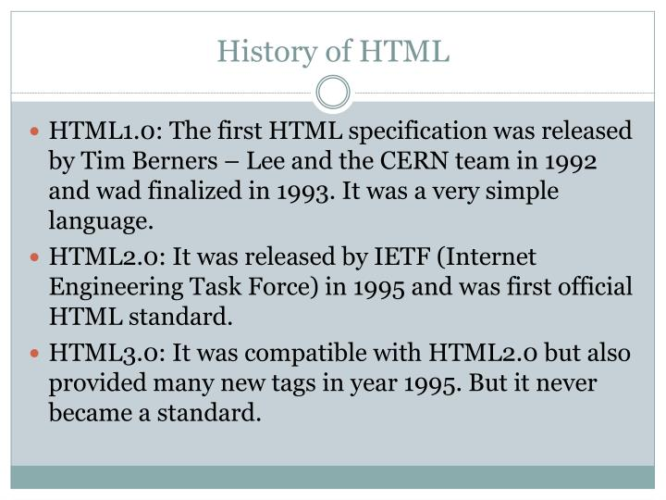
What is HTML & Why is HTML
HTML is the standard markup language for Web pages.
With HTML you can create your own Website
hypertext markup language

Slide 3





HOW YOU CAN START “HTML CODE”
Code Editor
.html File (index.html)
Code Editor

Slide 4
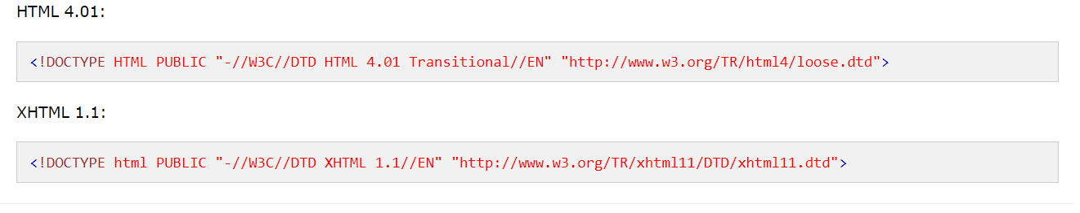
Basic code of HTML
<!DOCTYPE html>
<html>
<head>
<title>Page Title</title>
</head>
<body>
</body>
</html>

Slide 5
META TAG
Meta-data is represented by the <meta> tag
The <meta> tag provides information about the HTML document.
The contents of the <meta> tag are not displayed in the webpage.
Meta-data is used by browsers and search engines.
Get information about search engines and browsers web page through <meta> tags.
Meta:
viewport

Slide 6
Lets learn some important html tag
Tag
Attributes
<h1> to <h6>
<p>Content</p>
<span> Content </span>
<div>Content</div>
<br>Content</br>
<small>small</small>
<hr>
<hr size=“10px” color=“red”>
<div style=“width:300px;height:200px;background:red;></div>

Slide 7
<del></del>
<form></form>
<input type=“
text/email/password/number/radio/date/color/search/checkbox/time
”>
<textarea></textarea>
<button></button>
<input type=“submit”>
<lable></label>
<img>
<a></a>
<select></select>
<datalist></datalist>
<table></table>
<iframe></iframe>
<audio></audio>
<video></video>

Slide 8
HTML LIST
Order List
Unorder List
Nested List
<ol></ol>
<ul></ul>

Slide 9
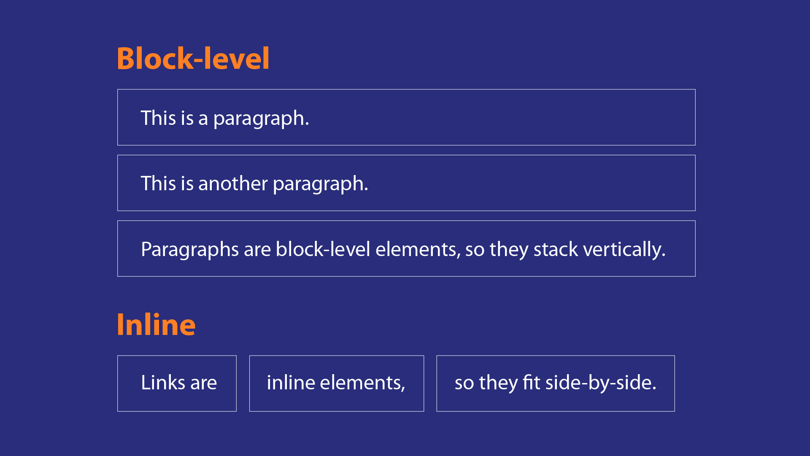
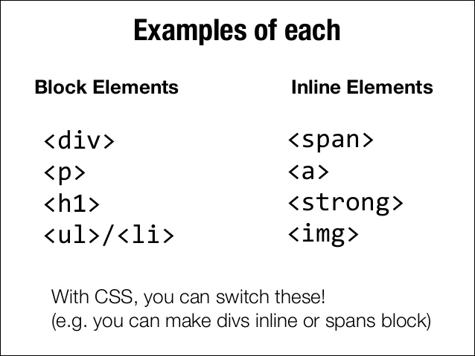
Inline And Block Level Elements

Slide 10

Interview Questions
Medium

Slide 11


